Slide 1
FCI E-campus
Supervised by
Dr. Mohammed Nassef
TA. Nora Abdelhamid
Implemented by
20140169 | Abdulaziz Mahmoud Abdulaziz
20140163 | Abdelrahman Mahmoud Mohamed
20140197 | Amr Magdy Mohamed Ezzat
20140030 | Ahmed Abdel-Mohsen Ahmed
20140170 | Abdallah Abdelazim Abdallah

Slide 2
Project idea
FCI E-campus: Timetable & Materials Organizer.
Our app helps students stay organized by providing them with their schedule, depending on what courses they have registered.
It also notifies them for new announcements, upcoming quizzes and assignments deliveries to help them keep track with their courses.
The app will organize downloading and uploading materials.
That’s not it, the app will provide a forum for the students to communicate with each other.
And many, many more.

Slide 3
Project idea
Domain of interest: Software Engineering.

Slide 4
Problem significance
What is the Problem we are going to solve?
Students are dispersed between many places: E-comm, Facebook, Acadox, Gdrive, …
Students lose grades, by losing track of assignments, quizzes & materials.
No easy way of communication between students & Teachers (professors & TAs)
Notes:
Dispersed: مشتت

Slide 5
FCI E-campus
No more Facebook
No more Acadox
No more mess

Slide 6
System Analysis and Design: System architecture
Our system uses Service-Oriented Architecture (SOA).
RESTful Web Services provided by the backend for the front-end clients
Notes:
A service is a discrete unit of functionality that can be accessed remotely and acted upon and updated independently, such as retrieving a credit card statement online.

Slide 7
System Analysis and Design: Stakeholders
Students at FCI
FCI professors, TAs, Administration.
Notes:
Stakeholder: a person with an interest or concern in something, especially a business.

Slide 8
System Analysis and Design: Functional Requirements
The app will allow each student, professor and TA to own an account but everyone has special permissions and capabilities in the system. Students don’t need to be verified but teachers do.
A Schedule with courses lectures, labs and sections each student has according to his registered courses. This schedule shows the user what he/she has at every slot of the day (like lecture, lab, section or delivering assignments and tasks or exams).
A static map for the faculty which guides the students by showing the buildings and the location of each lecture/section hall as well as professors’ offices, TAs’ office, the library, the mosque, the restaurant, etc…

Slide 9
System Analysis and Design: Functional Requirements
For each course the student is registered in there will be a resources screen which includes the materials for this course.
Teachers & the moderator students can upload materials to other students in their courses.
Allow Professors & TAs to add tasks to the courses they are assigned to. These tasks can be assignments, lab tasks, quizzes, etc... Each task will have a due date. These tasks appear on students’ schedules & students will receive a notification when a new task is added.
The app will have an Announcements Screen to inform students with any new announcements made by the Admin. Relating to the faculty in general, not to a specific course.

Slide 10
System Analysis and Design: Functional Requirements
Each course will have a Q/A Forum. The course students can post in the course forum to ask a question (related to this course) and other students, professors and TAs can answer.
EXTRA STUFF:
Tasks can be set to require students to upload their solutions. Students need to upload their solutions before due date.
Students will get notifications regularly to remind them of their tasks that has a near due date.
The app will allow users (professors, students or TAs) to send direct private messages to any other user.

Slide 11
System Analysis and Design: Non-functional Requirements
Accessibility
Due to the spreading of smart phones that uses android systems our application can be accessed by large community “as it will be an android app”.
Extensibility
We can add easily more features in our app in the future “that is what we decide to do in our project there is extra functions that we will added later.
Cost
Our app will be for free
Availability
Our app is available 24-hours.

Slide 12
System Analysis and Design: Non-functional Requirements
Deployment
Our app will be available on app store.
Efficiency
Our app will use only the needed martials “schedule for the student will contains the schedule of the courses that he registered in only without containing the schedule of the other courses.
Effectiveness
Our app will have all the features that the students needed instead of using more than one app.

Slide 13
System Analysis and Design: Non-functional Requirements
Interoperability
Our app can be used easily by other colleges.
Maintainability
If any user facing a problem in the app he can easily report it and we will repair it.
Modifiability
Some features can be modified easily like the shape of the schedule.
Safety
The data of any user will be completely save as it will not access by any other user.
Open-source
The source code will be available for any one.
Usability
Simple UI that help the user to use its functions easily.

Slide 14
System Analysis and Design: Use-case Diagram

Slide 15
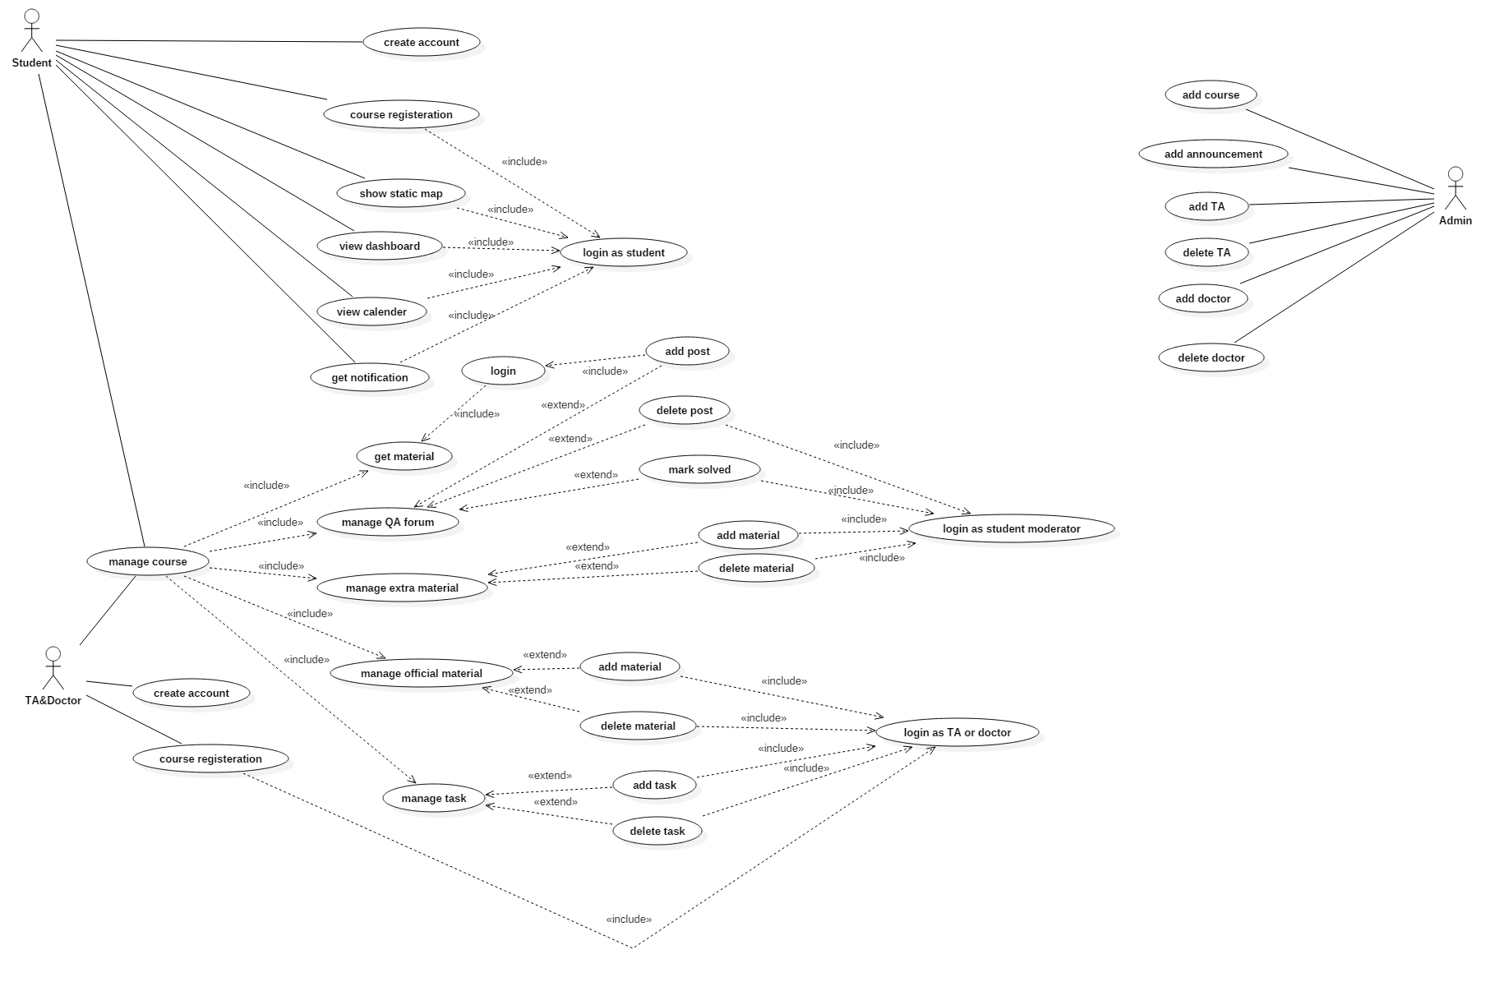

Slide 16
System Analysis and Design: Sample Use-cases

Slide 17
Use Case ID: | 1
Use Case Name: | Login
Actors: | TA/Doctor – Student – Moderator student
Pre-conditions: | User register in the app and validate his account
Post-conditions: | ______________________
Flow of events: | User Action | System Action
 | User Selects to login
 |  | System returns Login page
 | User enters his username User enters his password
 |  | System Verifies his information System logs him in to his account
Exceptions: | User Action | System Action
 | User Enter username and Password
 |  | username does not exist or password is wrong System rejects the Login System demands the user to enter correct username and password
Includes:
Notes and Issues: | Login will identify if the account corresponds to TA/Doctor, Student or Moderator student.

Slide 18
Use Case ID: | 2
Use Case Name: | TA/Doctor register
Actors: | TA/Doctor
Pre-conditions: | TA/Doctor has a valid academic E-mail
Post-conditions: | TA/Doctor validate his account from the mail sent to his academic mail
Flow of events: | User Action | System Action
 | TA/Doctor select to register
 |  | System returns registration page
 | Enter the required information
 |  | System check that neither of his data violate the specifications System sent a verification code to the entered academic mail
 | TA/Doctor enters the verification code
 |  | System match the verification code creates the account
Exceptions: | User Action | System Action
 | TA/Doctor entered data that violate the specifications
 |  | System recognize that the entered data violate the specifications System demand the TA/Doctor to enter his data again in right manner.
Includes:
Notes and Issues: | If TA/Doctor enter invalid E-mail he will not be able to validate his account so he will not be able to complete registration.

Slide 19
Use Case ID: | 3
Use Case Name: | Course registration
Actors: | Student
Pre-conditions: | Login
Post-conditions: | ____________________
Flow of events: | User Action | System Action
 | Student Show courses
 |  | System return List of courses
 | Student select a specific course
 |  | System return course information and some choices
 | Student Select register in this course
 |  | System return a box to write course code
 | Student enter course code
 |  | System check that the course code is right System add this course to Student courses
Exceptions: | User Action | System Action
 | Student entered invalid course code
 |  | System demand to enter course code again
Includes:
Notes and Issues: | You should have the course code to register in the course

Slide 20
Use Case ID: | 4
Use Case Name: | Add Material
Actors: | TA/Doctor – Moderator student
Pre-conditions: | Login – Assign to this course
Post-conditions: | ____________________
Flow of events: | User Action | System Action
 | User shows the courses he assigned to
 |  | System return List of courses
 | User select the course he wanted
 |  | System return course information and some choices
 | User select add material
 |  | System return a box to upload material
 | User upload material
 |  | System assign the uploaded material to the course System send notification to the students assigned to this course
Exceptions: | User Action | System Action
Includes:
Notes and Issues: | If you are student the add material button will not appear to you

Slide 21
System Analysis and Design: Component Diagram

Slide 22
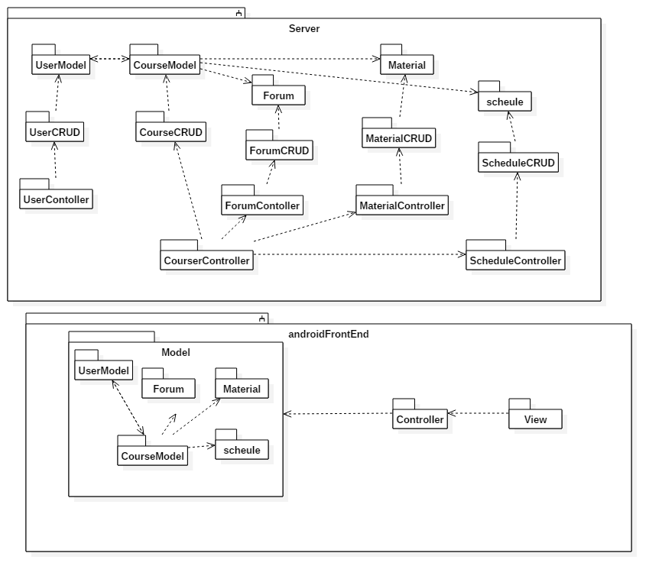

Slide 23
System Analysis and Design: Class Diagram

Slide 24
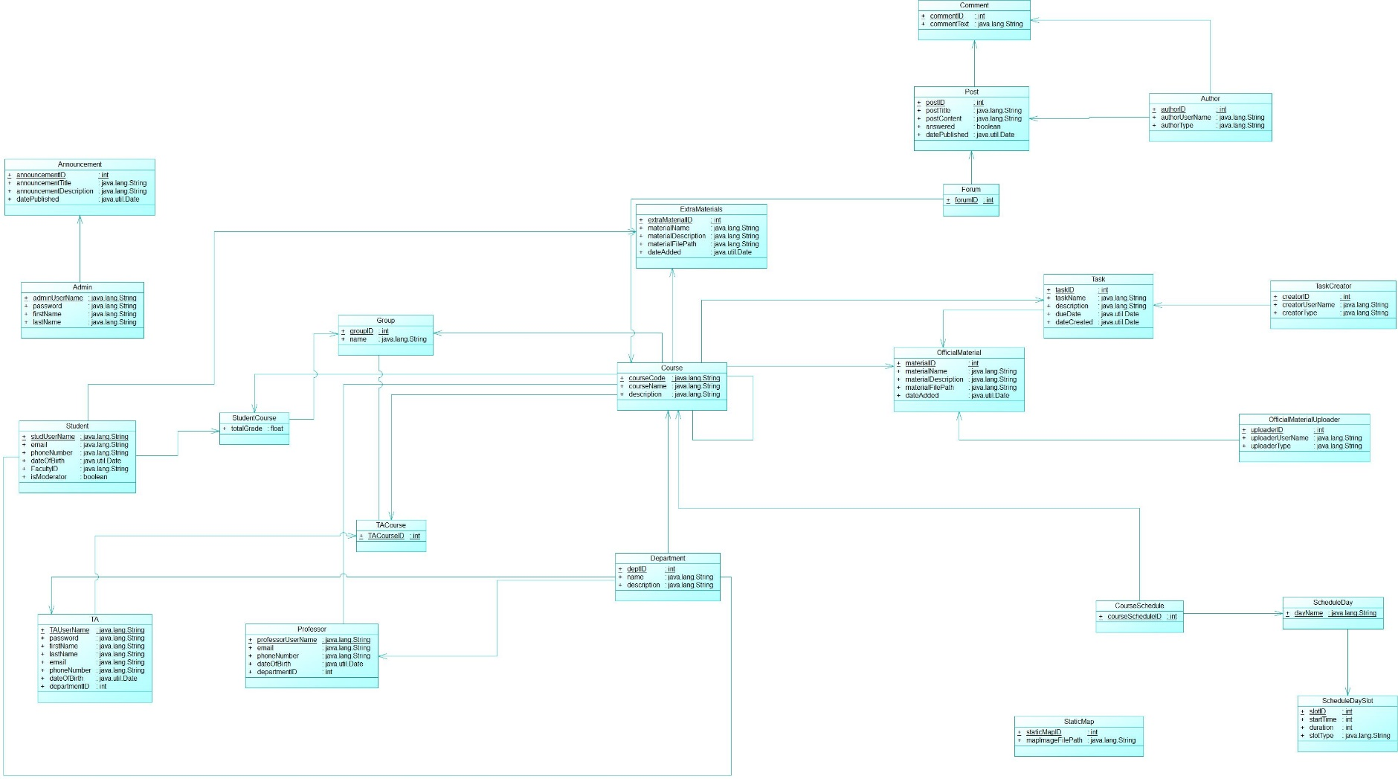
Model Classes

Slide 25
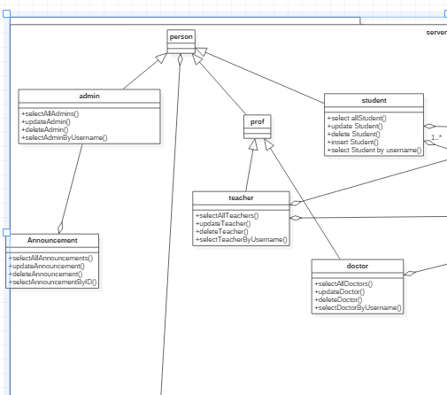
User CRUD

Slide 26
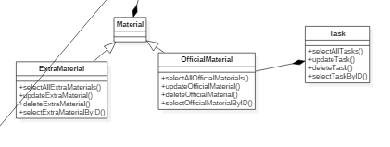
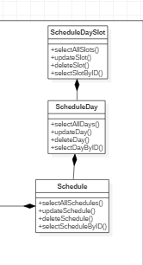
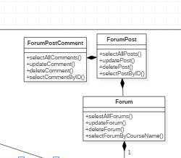
Material Package
Forum package
Schedule Package

Slide 27
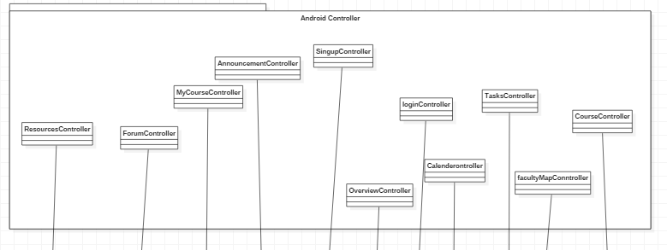
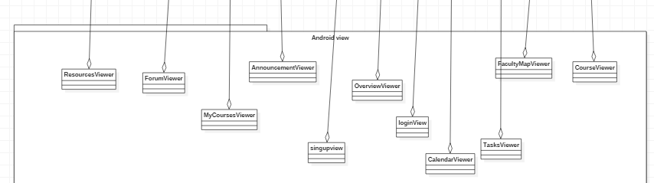
Android Controller
Android View

Slide 28
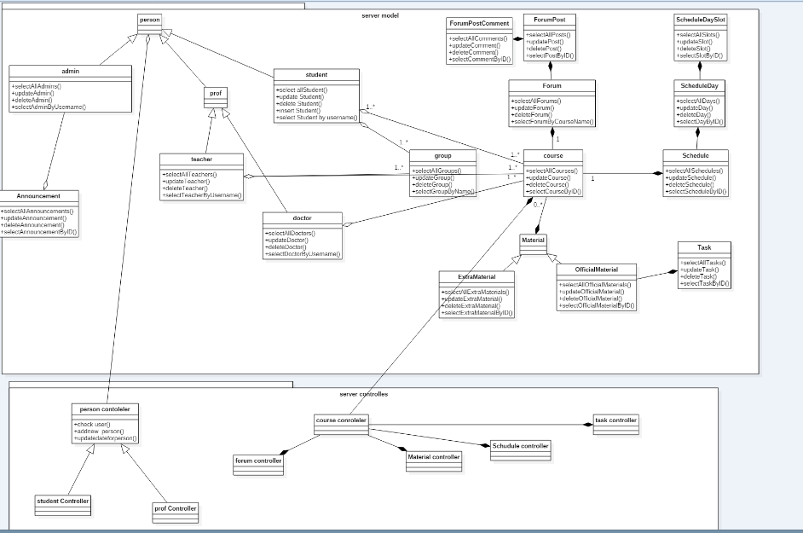

Slide 29
System Analysis and Design: Sequence Diagram

Slide 30
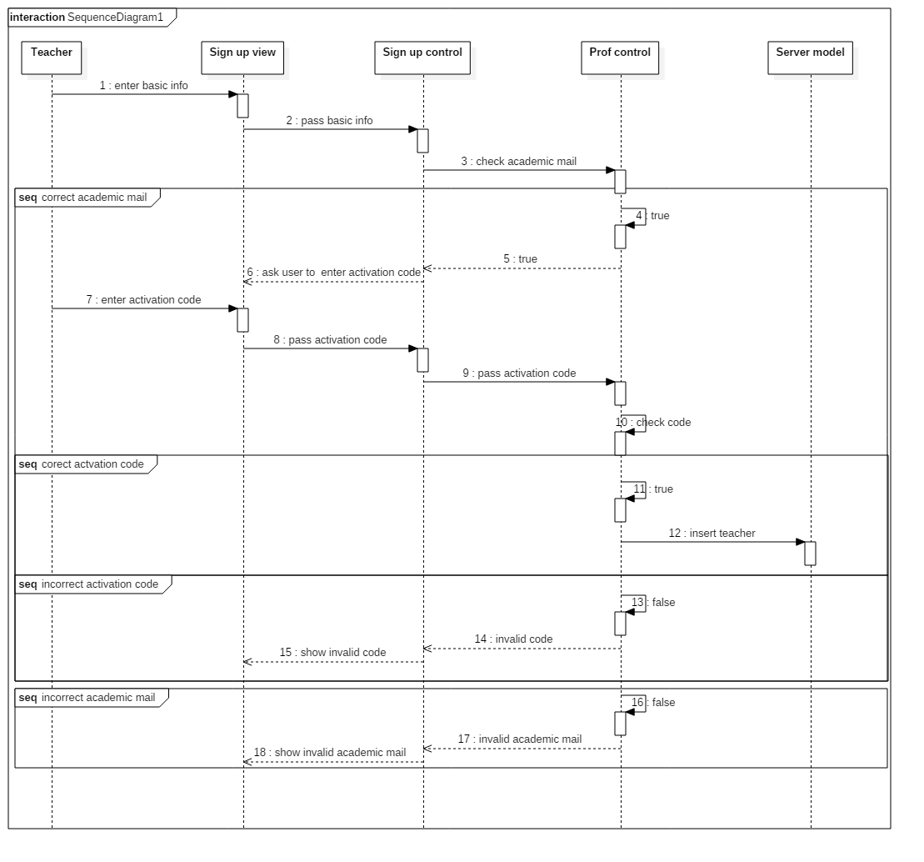
Teacher Sign UP

Slide 31
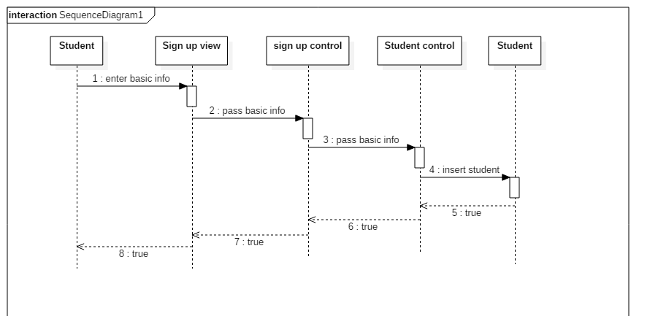
Student Sign Up

Slide 32
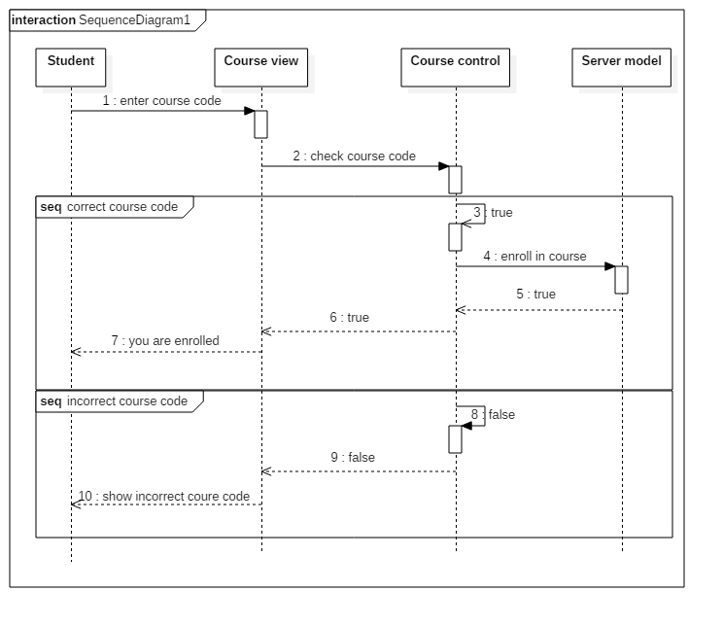
Course Registration

Slide 33
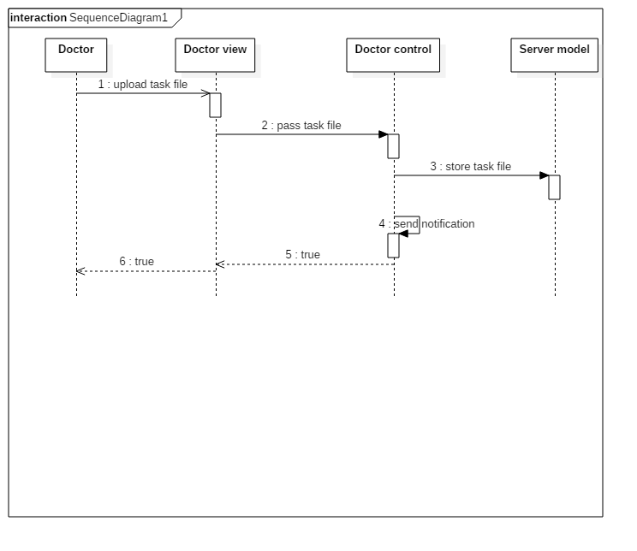
Add Task

Slide 34
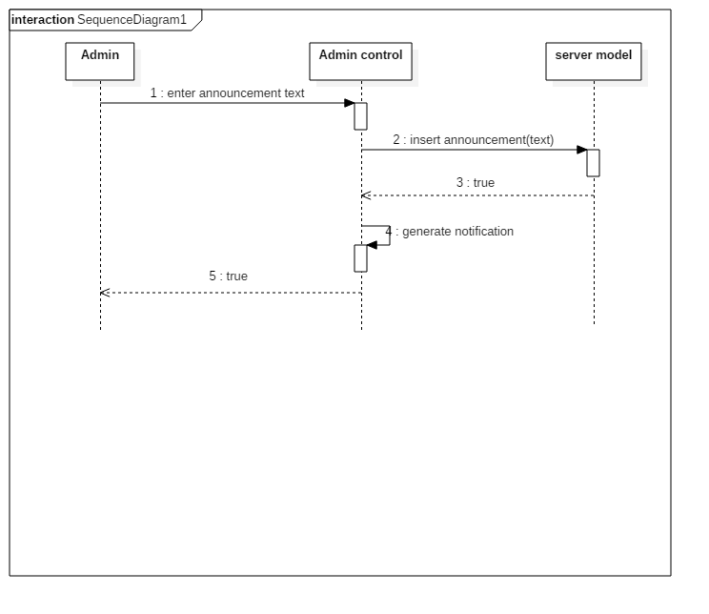
Add Announcements

Slide 35
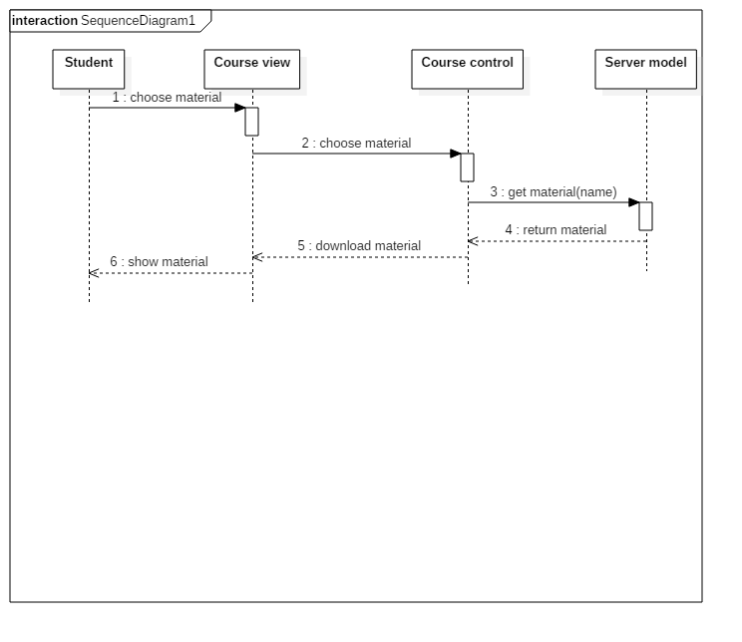
Get Material

Slide 36
System Analysis and Design: ERD

Slide 37
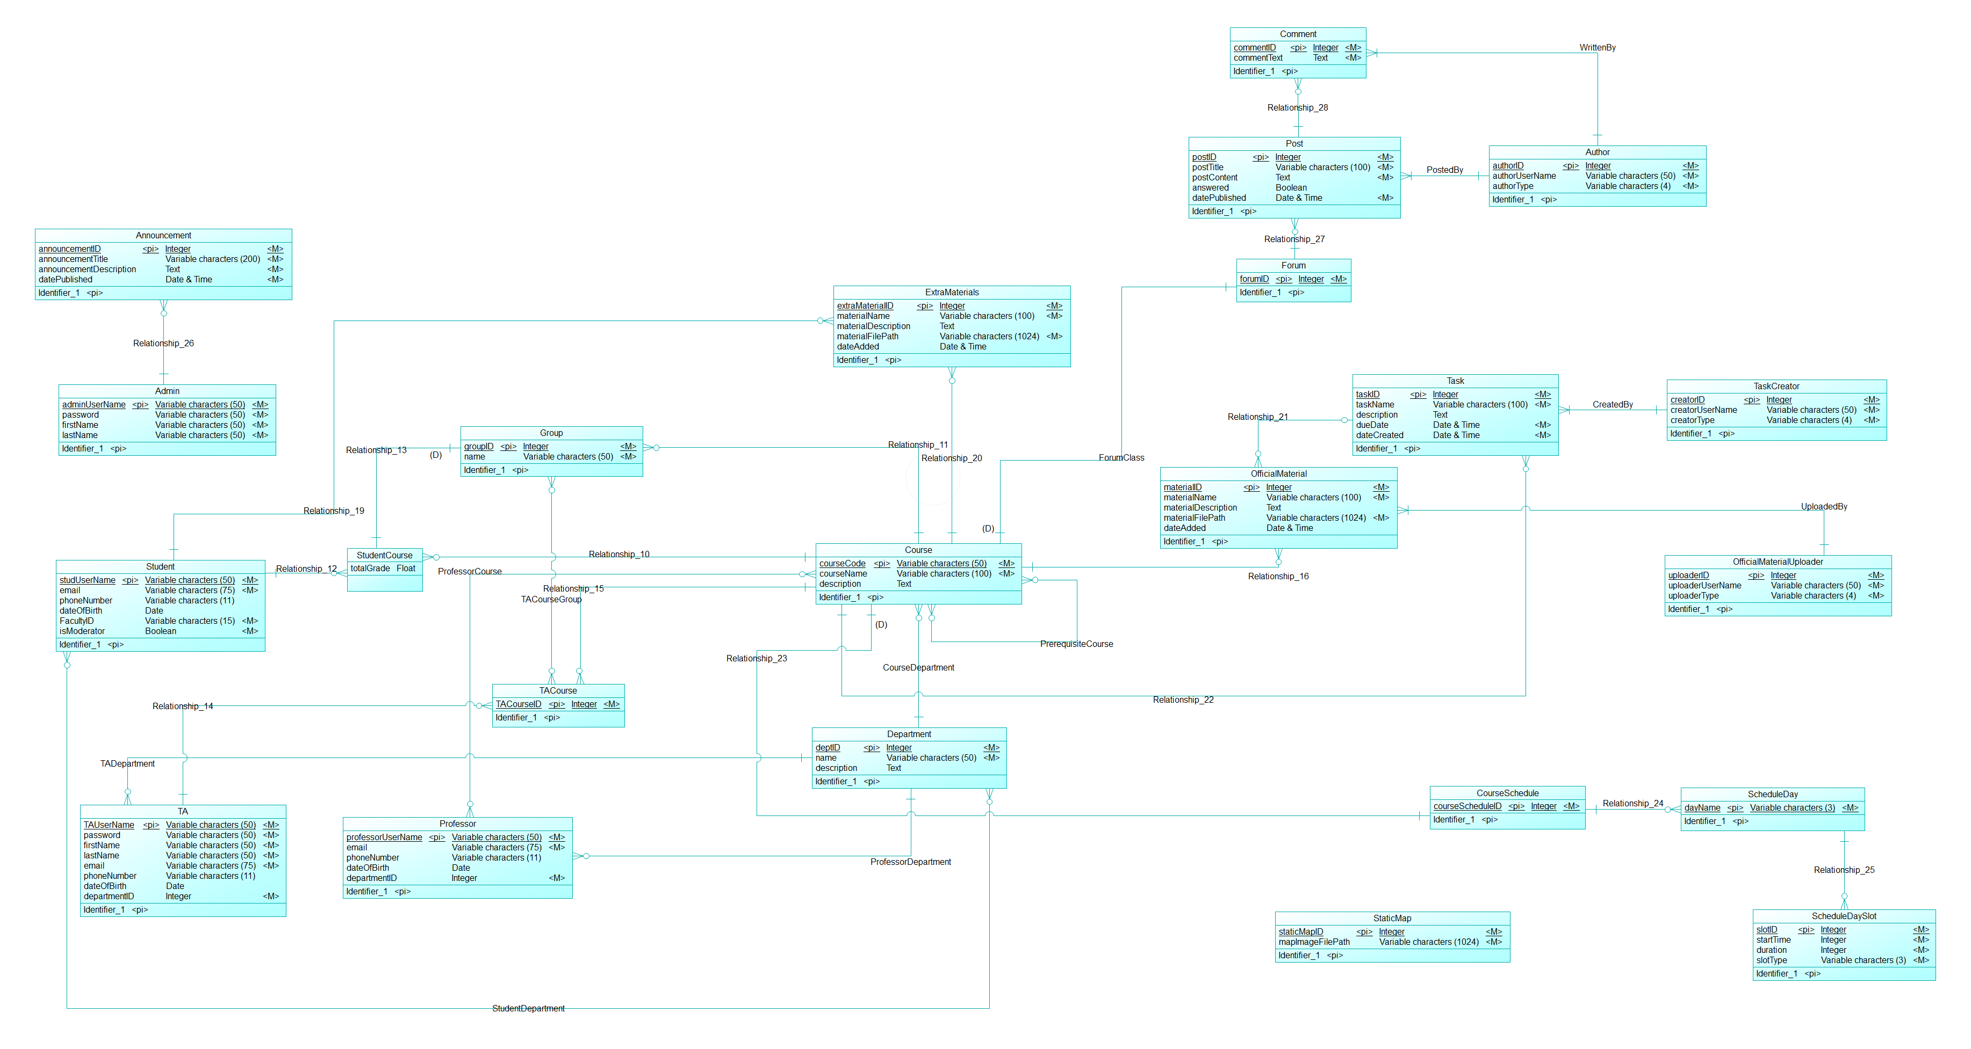
Conceptual Data Model

Slide 38
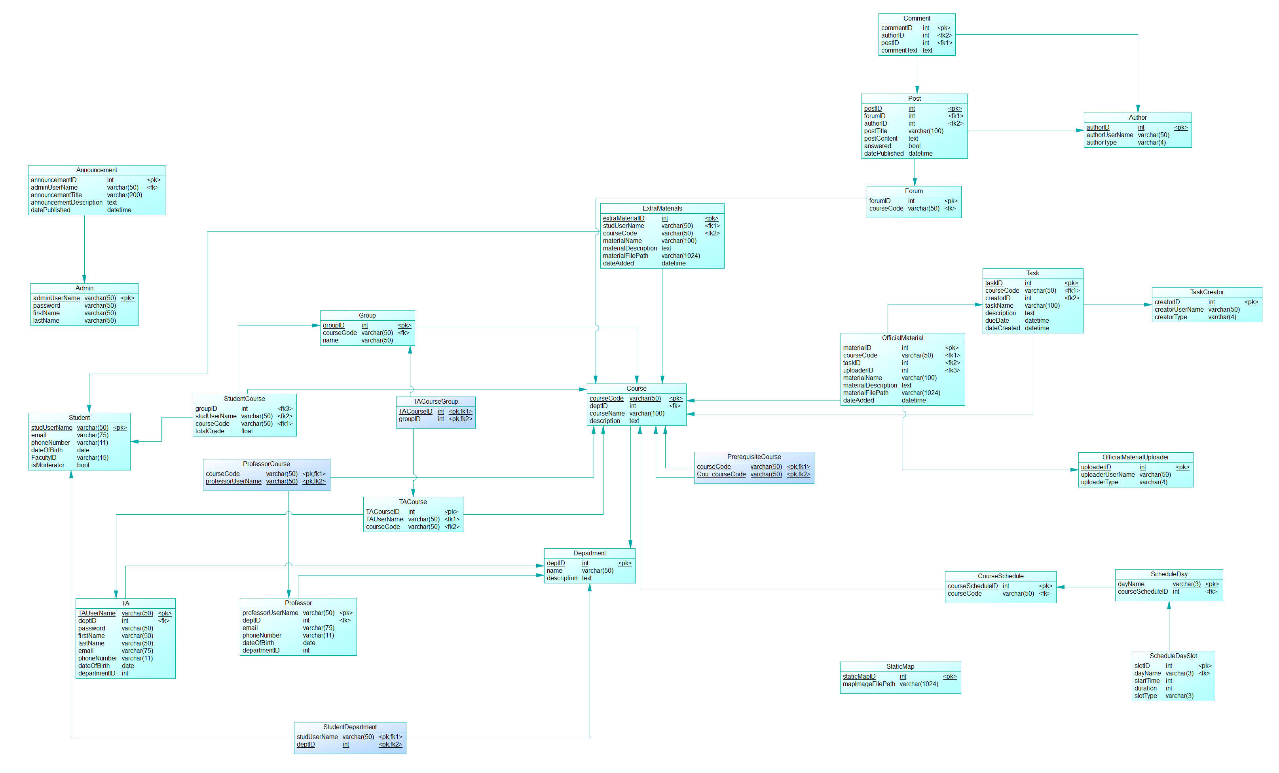
Physical Data Model

Slide 39
Draft of screenshots of expected system screens

Slide 40
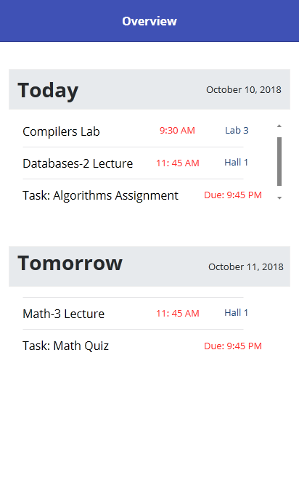
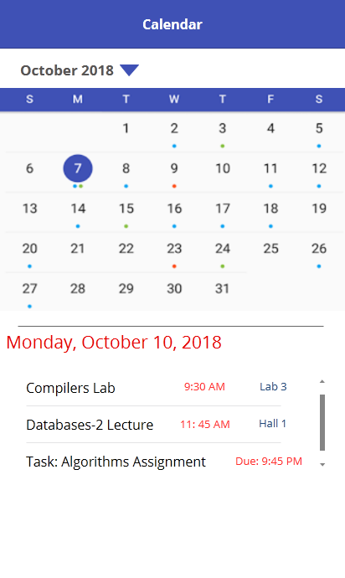
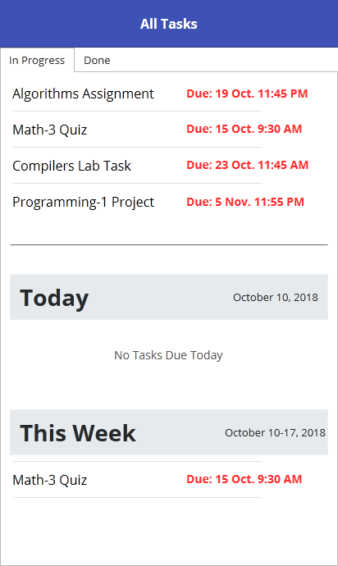

Slide 41
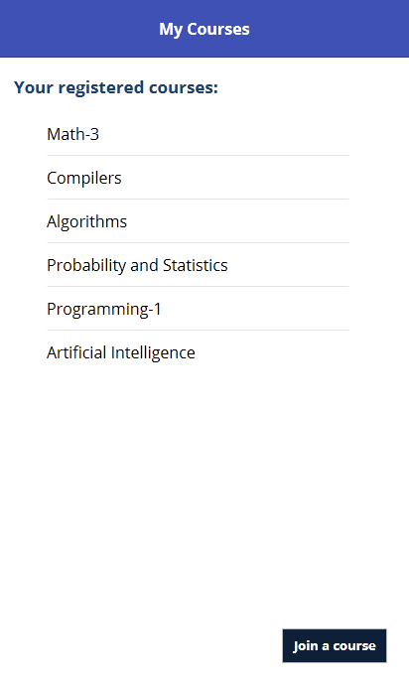
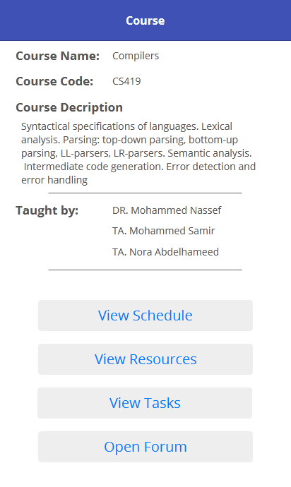
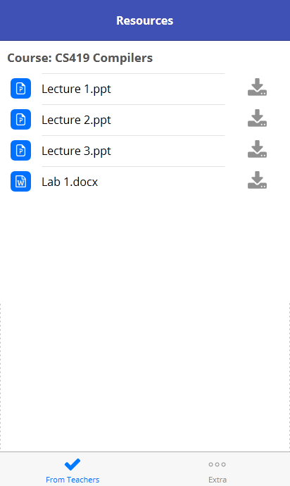

Slide 42
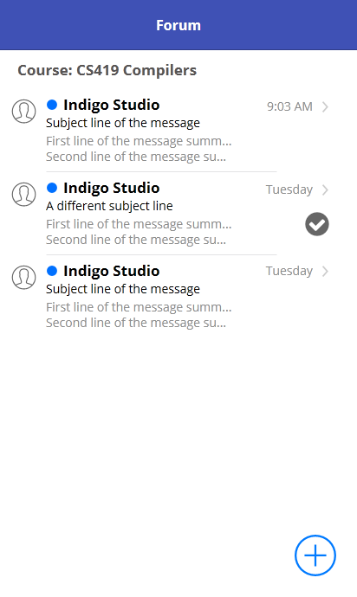
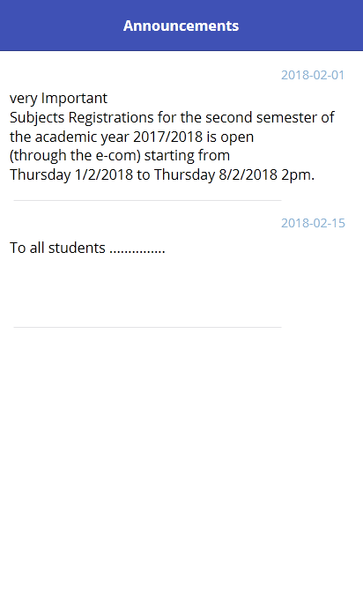
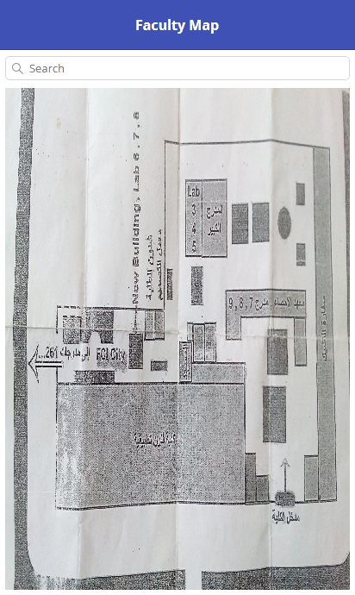

Slide 43
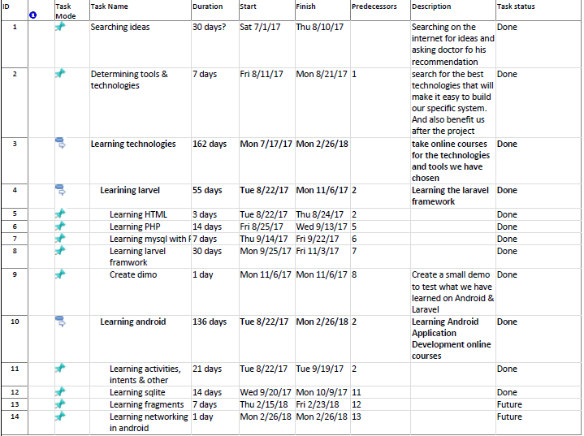
Time Plan

Slide 44
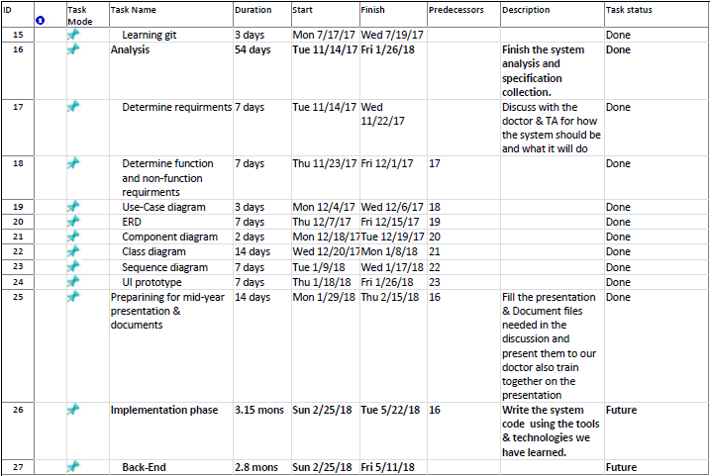

Slide 45
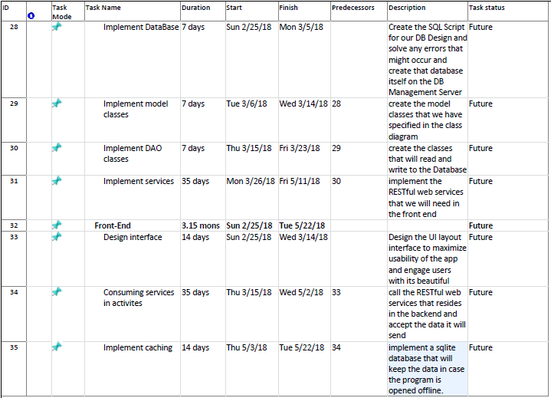

Slide 46
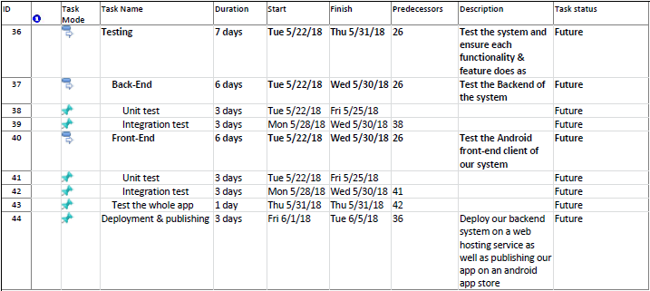

Slide 47
Conclusion

